Slide 1
DATA ANALYST Project portfolio
D.SOORYA

Slide 2
acknowledgement
Karthik Veer Sir
I would like to thank you for your diligence and direction in this course.
Looking forward for more guided sessions and learning new field of study.
Forever grateful.

Slide 3
AGENDA
About – Who am I?
Project 1 – Billionaires Statistical Analysis Dataset
Project 2 – Cars India Dataset below Rs 20 lakhs
Project 3 - S&P 500 Stock Prices Analysis Dataset
Project 4 – Kickstarter Project Crowdfunding
Project 5 – Northwind Traders 2013-2015
Project – 6 New York Housing Data Analysis
Timeline
Tools used
​Summary​

Slide 4
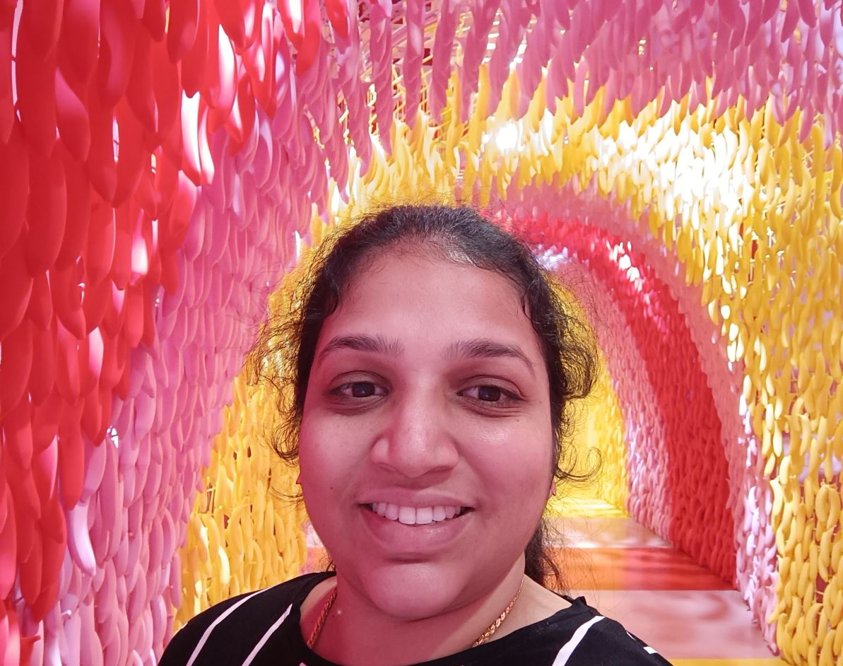
Who am I?
A devoted Agriculturalist and a Junior Investment Consultant in a family-run business which has leveraged my entrepreneurial skills of prospecting, conflict management, relationship building, training labors and risk control.
Data Analysis is a virtue to my transforming career. Such diversity of the industrial exposure has a substantial impact on my new course of career.
Scroll down to view my hands on guided projects solved during the course of study.

Slide 5
Project 1
Billionaires Statistics Dataset
Source : Kaggle

Slide 6
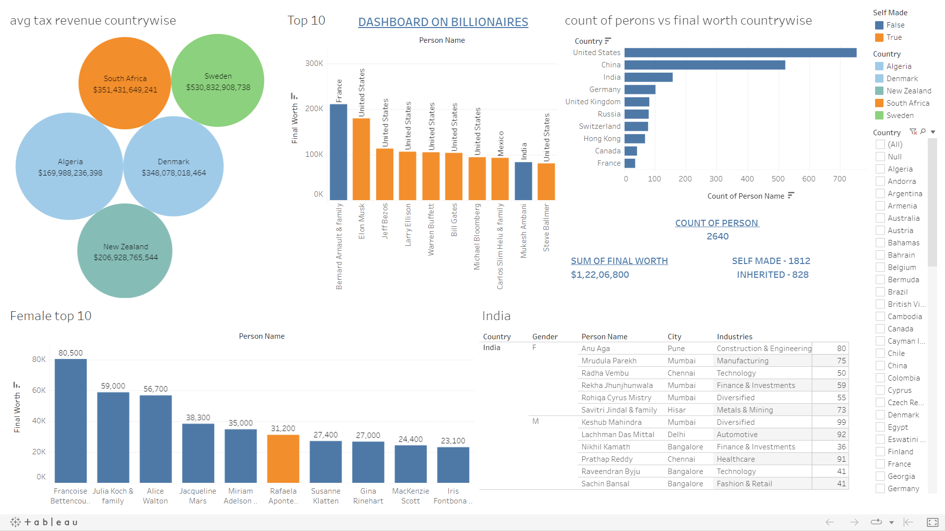
Dashboard

Slide 7
Insights
Bernard Arnault, Chairman & CEO of LVMH Moet Hennessy Louis Vuitton, France is the richest amongst the billionaires of the world with a net worth of $2,11B.
Richest Woman is Francoise Bettencourt Meyers from Paris, France has a net worth of $80B.
United states has the highest billionaires of 754 that is 28.56% in the world which is greater than the following countries :
China - 523 that is 19.81%;
India - 157 that is 5.95%;
Germany – 102 that is 3.86%
United Kingdom – 82 that is 3.11%
Finance & Investment Category comprises of most of the billionaires count 372 which is 14.09%
World’s youngest billionaire is Clemente Del Vecchio, 18 years from Milan, Italy with a net worth of $35B. Likewise India’s youngest billionaire is Nikhil Kamath, 36 years from Bengaluru with a net worth of $11B.

Slide 8
Recommendation
As 34% of wealth is self-made by billionaires, young generation should never give up on failures and take more risk until they succeed.
Upgrading knowledge through secondary and tertiary education also plays a vital role in success and sustainability of the business.

Slide 9
Project 2
Cars India Dataset below Rs 20 lakhs
Source : Kaggle

Slide 10
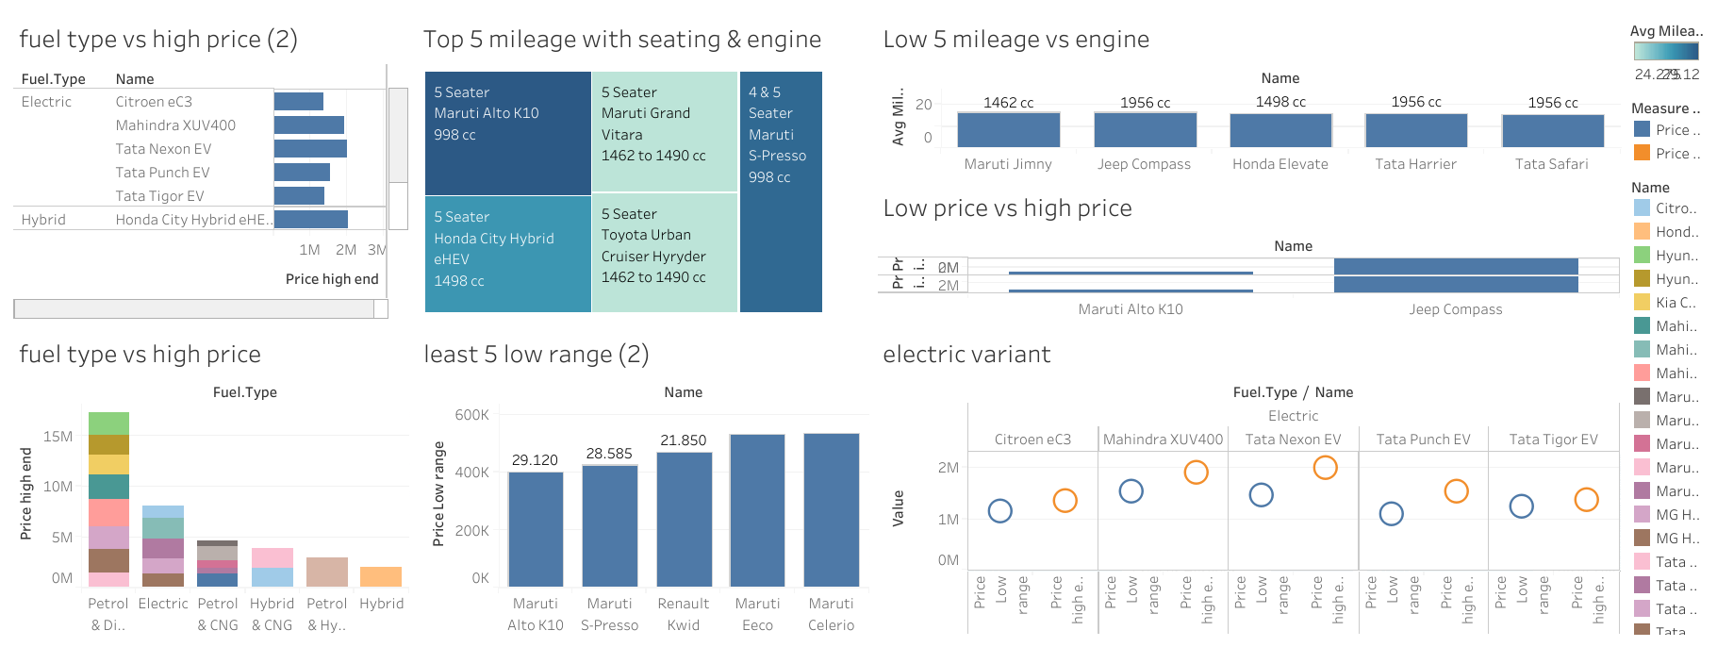
dashboard

Slide 11
insights
Total number of cars is 49
Highly Priced Car Range – Jeep Compass – Rs 20,69,000 to Rs 32,27000
Low Priced Car Range – Maruti Alta – RS 3,99,000 to Rs 5,96,000
Top 5 Mileage category Maruti Alto – 29.12, Maruti S Presso – 28.58, Honda City Hybrid – 27.10, Maruti Grand Vitara – 24.27, Toyota Urban Cruiser Hyryder – 24.27
As the engine capacity increases the mileage decrease

Slide 12
recommendation
Electric Variant cars are highly recommended to avoid gas emission pollution
Premium car segment best buy will be Toyota Innova Hycross (Rs 30,68,000) due to its engine capacity – 1987cc and its fuel type – Petrol & Hybrid

Slide 13
Project 3
S&P 500 Stock Prices Analysis Dataset
Source : Maven Analytics

Slide 14
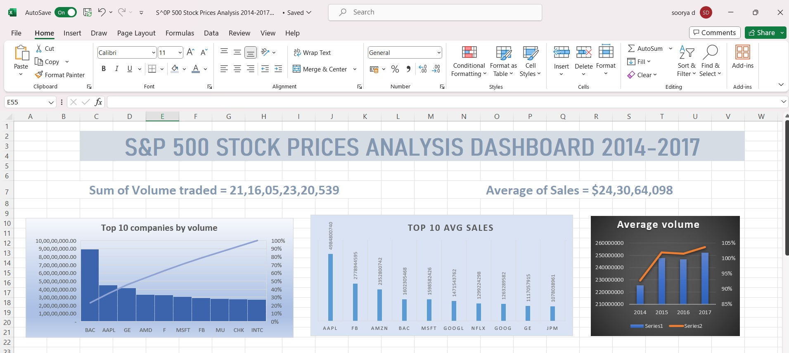
dashboard

Slide 15
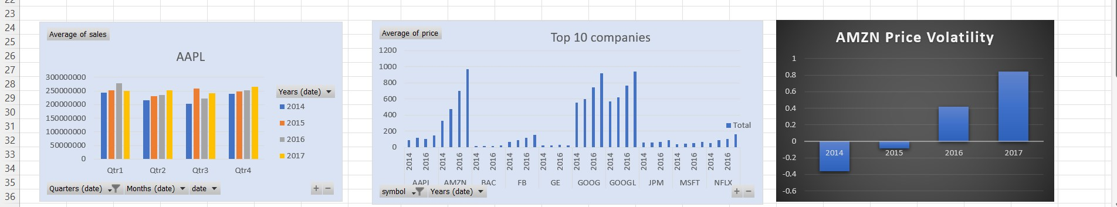

Slide 16
Insights
Largest traded volume stock is Bank of America Corp of an average - 8,93,62,903
Highest Average of Sales between 2014-2017 is Apple Inc of $4,98,48,00,740
Amazon's cluster column chart shows the price volatility
2017+0.84>
2016+0.14>
2015-0.08>
2014-0.36
Recommendation:
GOOGL - $722.68
Google stock in four years has a steady pricing, hence it is the most favourable to invest in.
Year | Price $ | Growth %
2014 | 568.5409 | -
2015 | 620.0267 | 9.05%
2016 | 763.4363 | 23.12%
2017 | 939.6134 | 23.09%

Slide 17
Project 4
KICKSTARTER PROJECT CROWDFUNDING 2009-2018
Source : Maven Analytics

Slide 18
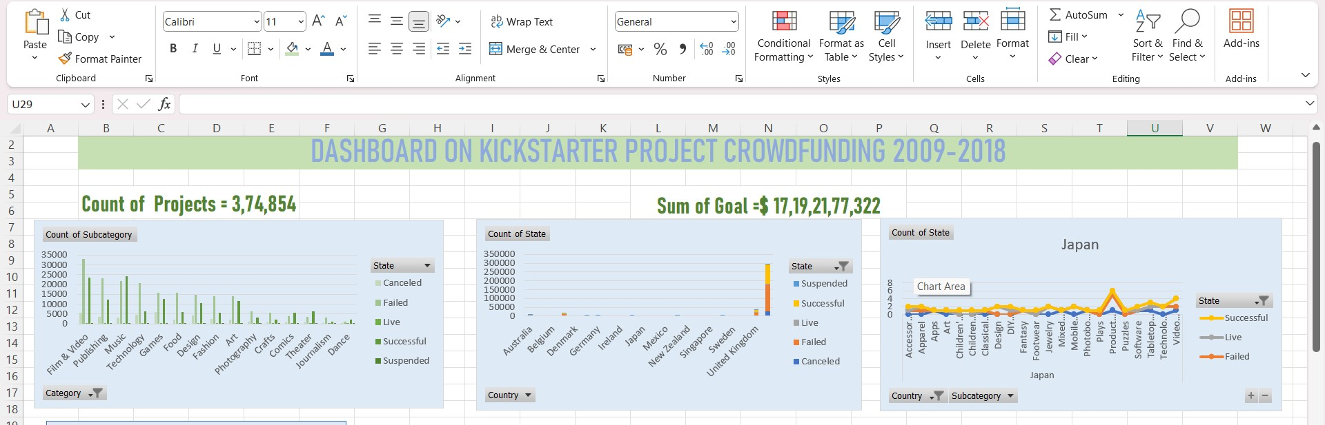
dashboard

Slide 19
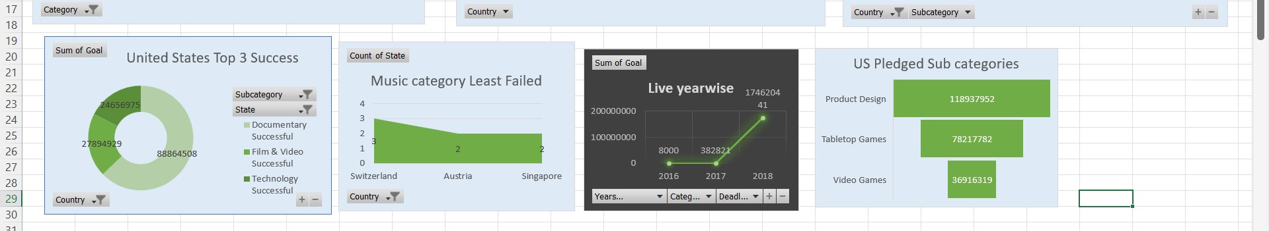

Slide 20
Insights
United States has the highest number of successful projects -1,09,299 comprising 29.16% and failed projects - 1,52,059 comprising of 40.56% of the total kickstarters.
Music Category has least failed in countries like Switzerland, Austria and Singapore.
Japan and Luxembourg has Nil projects Suspended.
Successful crowdfunding goal year was in 2015 with $23,38,33,537.
Japan has consistently successful in the following categories : Accessories, Childrens' book, Childrens' wear, DIY Electronics, Footwear, Software and Tabletop Games.
Recommendation:
Highest scope of investment is for Product Design category as the sum of Pledged amount shows the degree of interest of investors.
Reference : 2015 - US - Pledged amount $ 2,03,38,986 within 32 days of launch.

Slide 21
Project 5
NORTHWIND TRADERS 2013-2015
Source : Maven Analytics

Slide 22
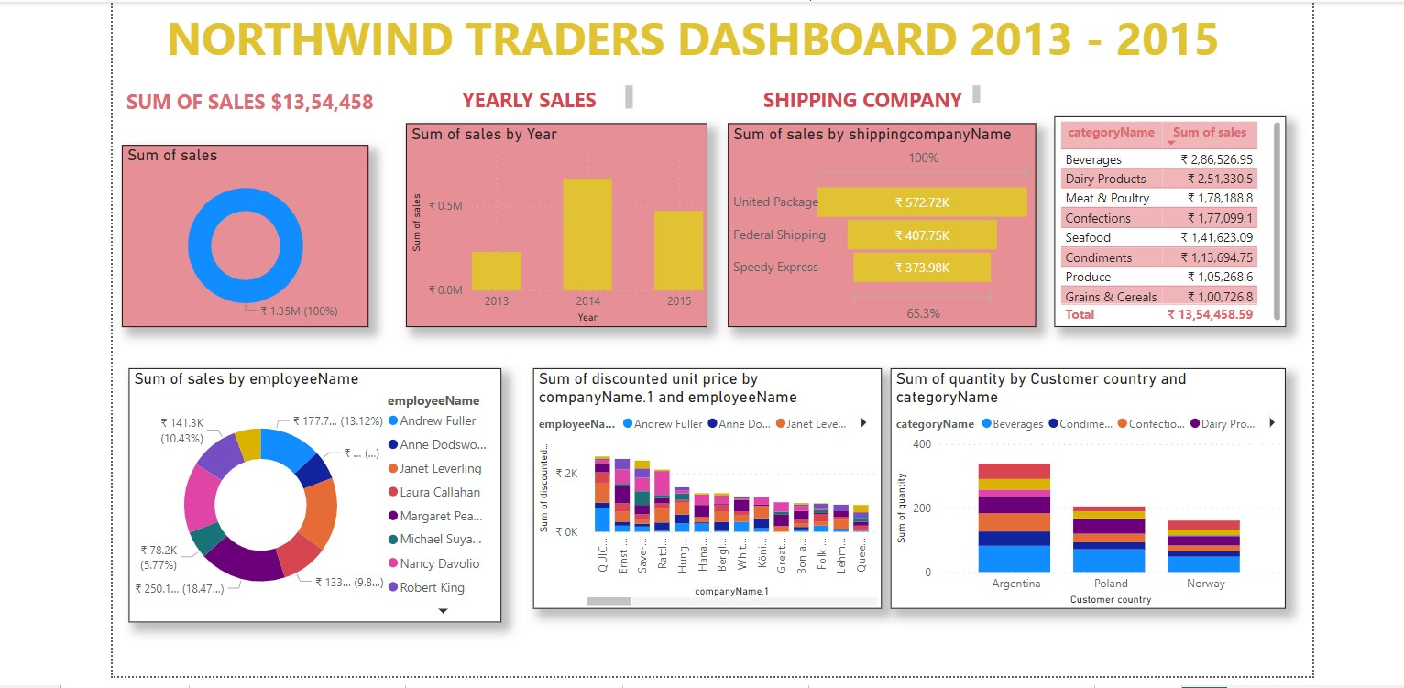
dashboard

Slide 23
INSIGHTS
Highest sum of sales was achieved by
Margaret Peacock - $2,50,187/18.47% >
Janet Leverling - $2,13,051/15.73% >
Nancy Davolia - $2,02,143/14.92%.
Year 2014 recorded the highest Sum of sales of $ 6,58,388.
highest count of order was on May 6th,2015.
Meat and Poultry were least selling products contributing 8% and 6% respectively.
The Unit Packaging Shipping Company handled approximately 40% of orders.
RECOMMENDATION
Product Category Beverages - 19%, Dairy - 17% and Confections - 15% has high demand, thus expansion of business in those area will yield more profit
High performing shipper company Unit Packaging can be collaborated more often due to their success in prompt delivery
Steven Buchanan should be trained with more incentives to boost sales
Chocolade category needs more marketing to get better order from rest of the 16 countries

Slide 24
Project 6
NEWYORK HOUSING DATA ANALYSIS
Source : Maven Analytics

Slide 25
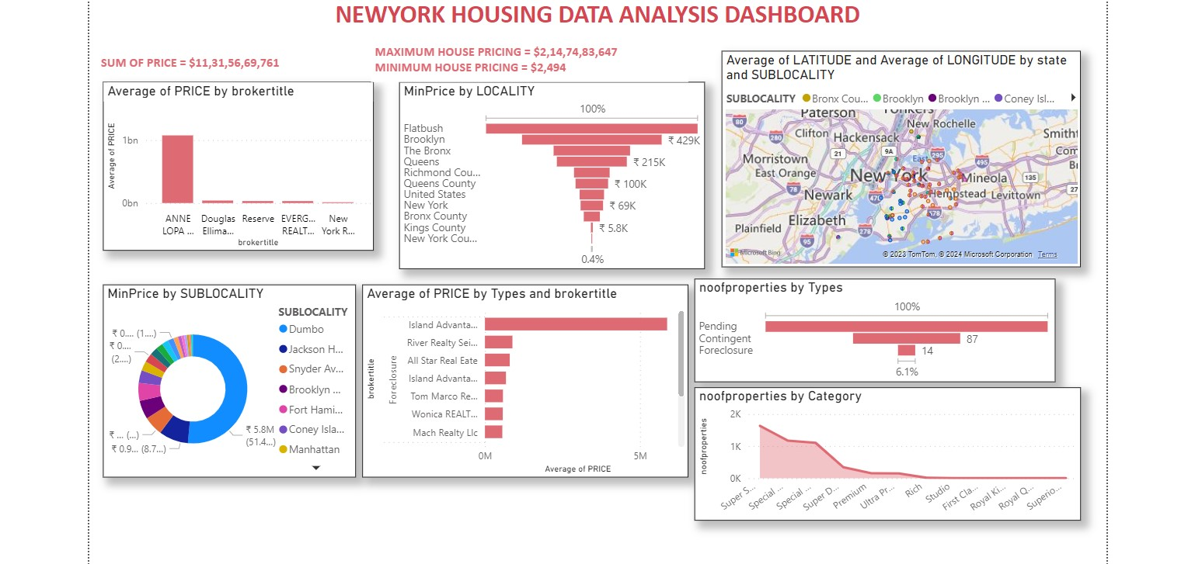
dashboard

Slide 26
INSIGHTS
Coldwell Bankereliale is the only broker for "Pending category" Project of avg price of $5,99,889 at NewYork.
Total no.of properties 4583 where
Compass -436 >
Douglas Elliman-575 >
Madison avenue - 109 >
Brown Harris Sten - 93 are the top 3 property dealers.
From "types"
Pending - 229 ,
Contingent - 87,
Foreclosure-14 we can conclude that there are 330 projects in progress.

Slide 27
recommendation
Best investment can be made with a minimum pricing in New York - $2494 and Brooklyn -$5800
The most expensive properties are around New York with maximum amenities having the maximum price of $ 21,47,48,364, so investments can be done for a premium buy or profitable returns.
There is a good scope of investment in Land or a 2 bedroom property type where the prices start from $5800 and $ 2494 respectively.

Slide 28
TIMELINE
Nov 2023
Dec 2023
JAN 2024
Feb 2024
Mar 2024
Data Visualization using Tableau
a. Excel Analysis using Pivot tables.
b. Data processing and repositories using Power BI
Managing data in relational database using SQL
Statistical Analysis

Slide 29

Tools used
To Visualize
To Analyze
Tableau
MS Excel
Power BI

Slide 30
SUMMARY
Seeking a position of entry level Data Analyst possessing strong analytical skills, basic programming, collaboration skills for utilizing data to solve problems.
Dashboards, insights and recommendations for the above datasets were done with data analytical and statistical tools to render accuracy in data processing to achieve success.

Slide 31
THANK YOU
D.SOORYA
soorya.dakshina@gmail.com

